Slide 1
Auto/pedagogy:
Authentic learning
for the 21st Century
@e_ducator
Simon Hughes
info@simonhughes.info
Dr Simon Hughes
BETT Show 2023

Slide 2
Today’s curriculum 😉
Find out more about auto/pedagogy
Reflect on adult and/or professional learning contexts (andragogy Knowles, 1968)
Consider transfer to pupil-centred contexts
Re-examine ‘interactivity’ and ‘tools’ in this space

Slide 3
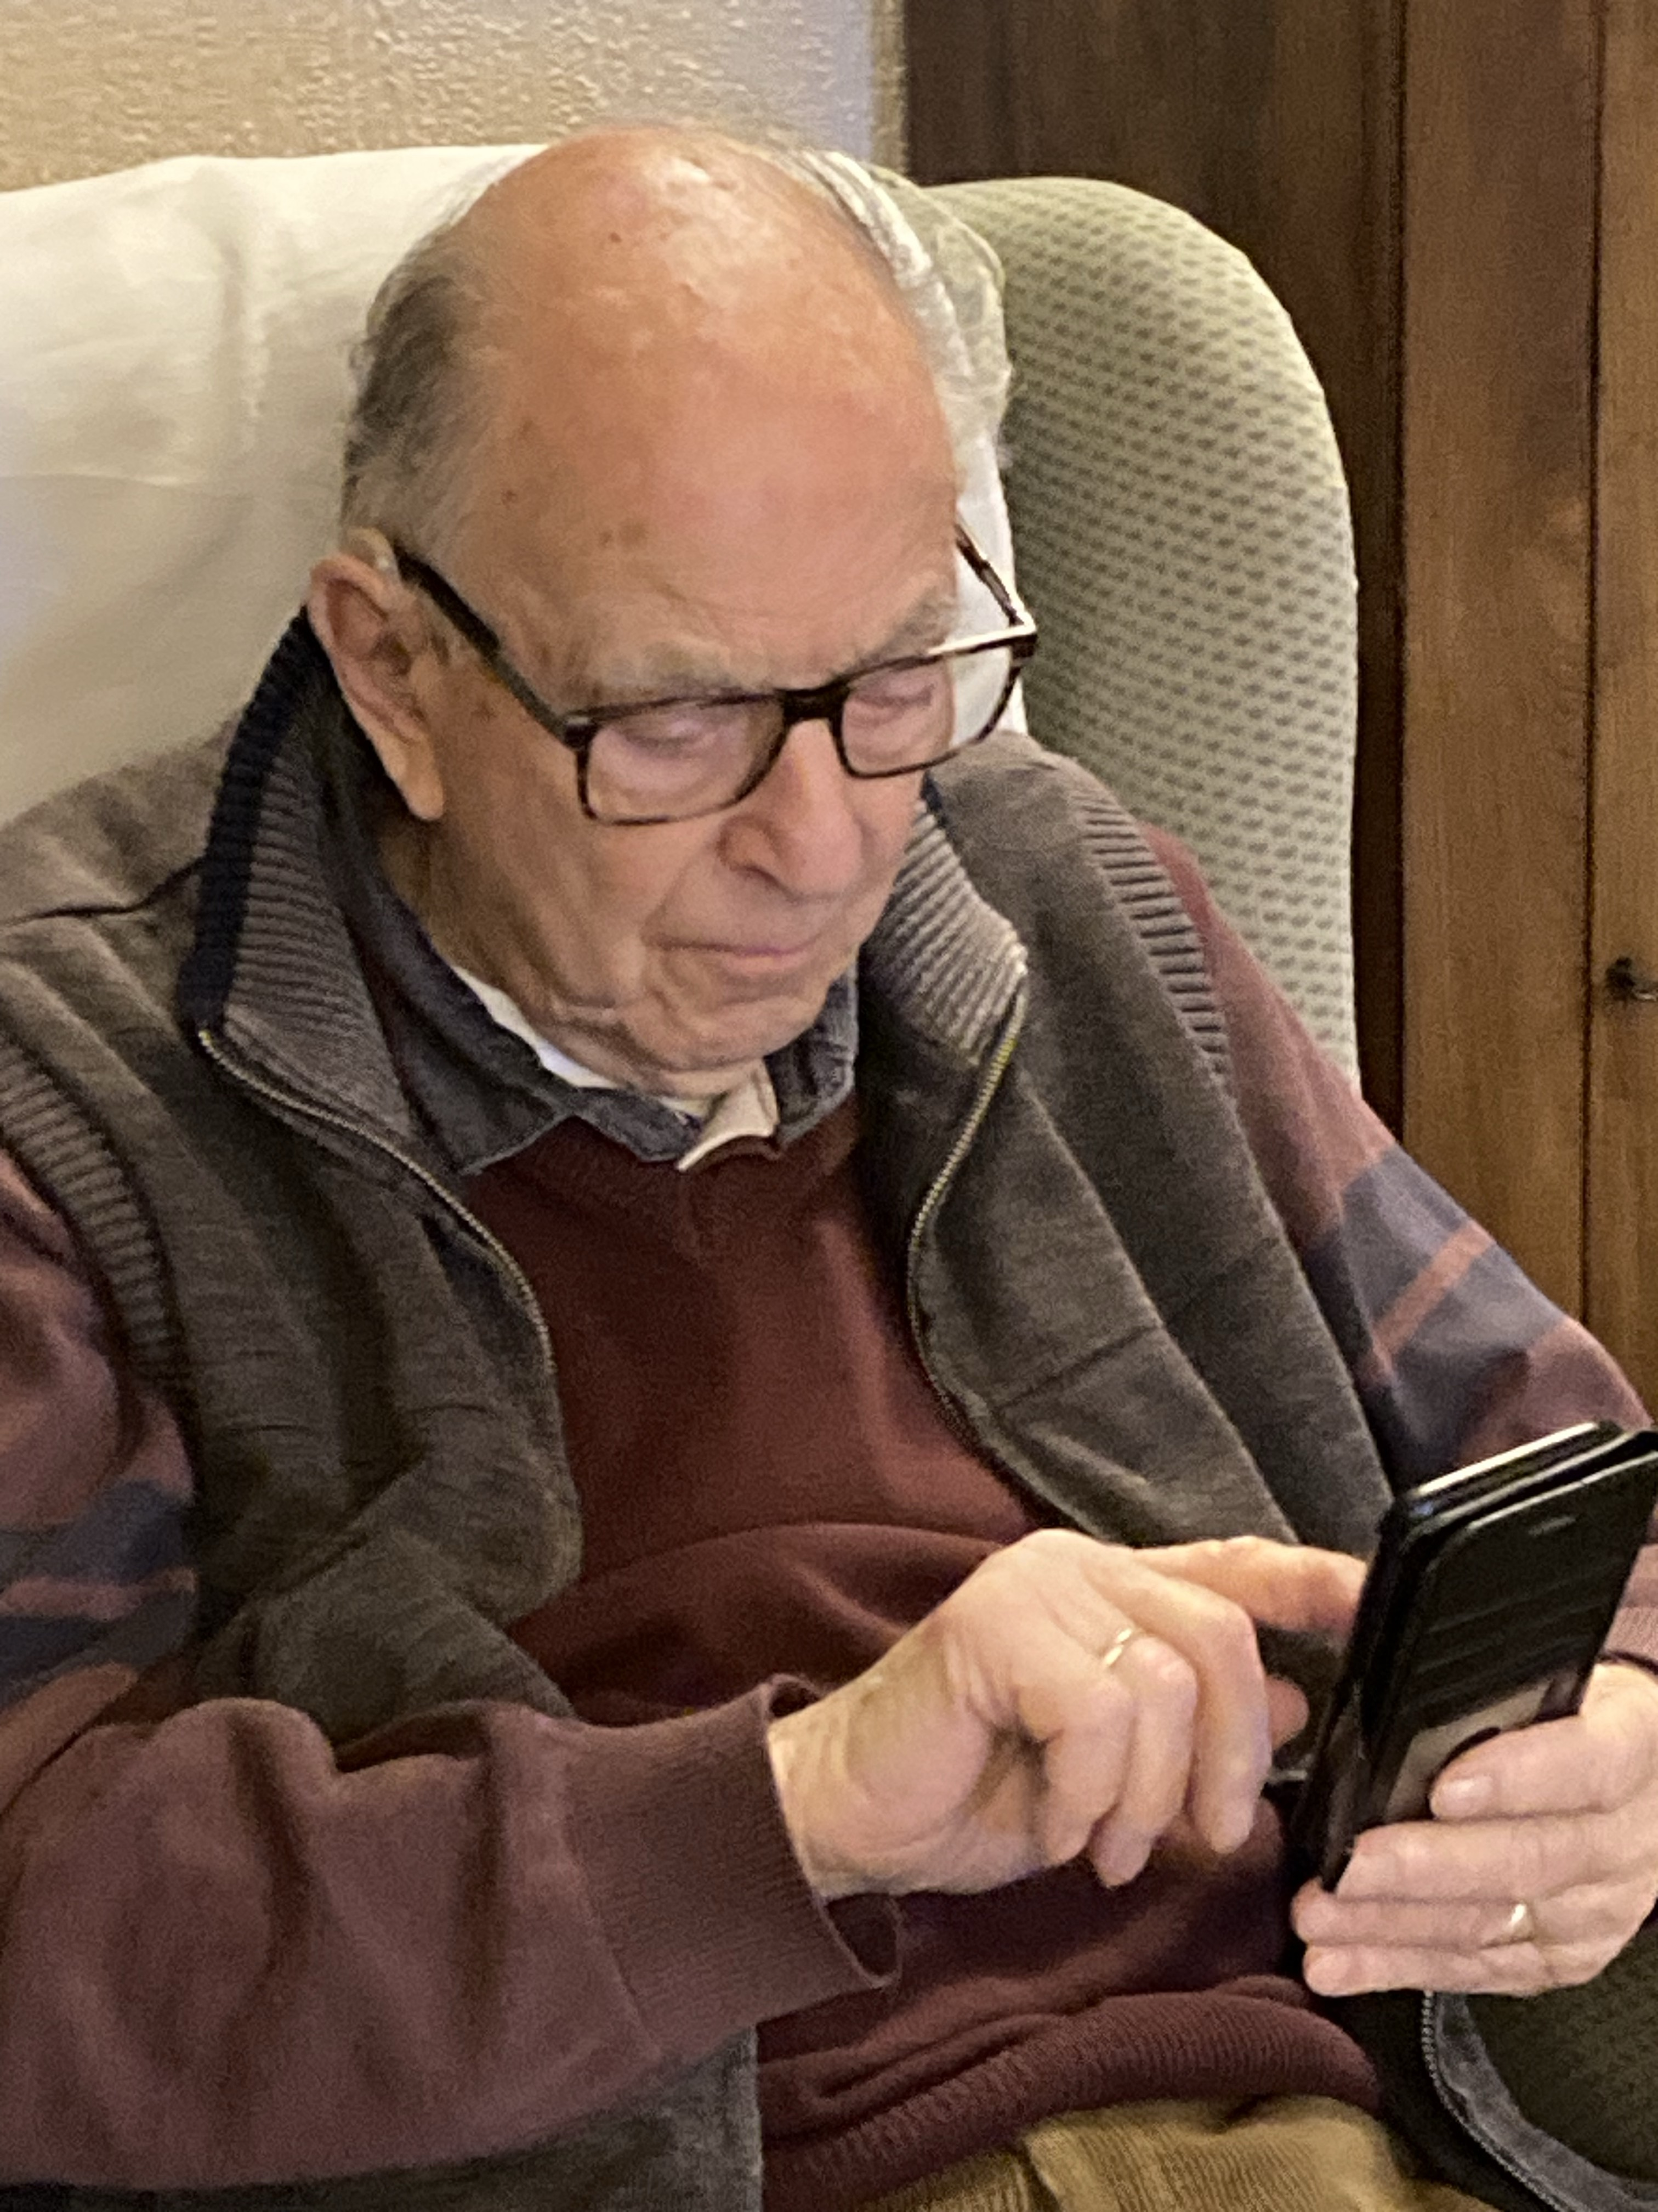
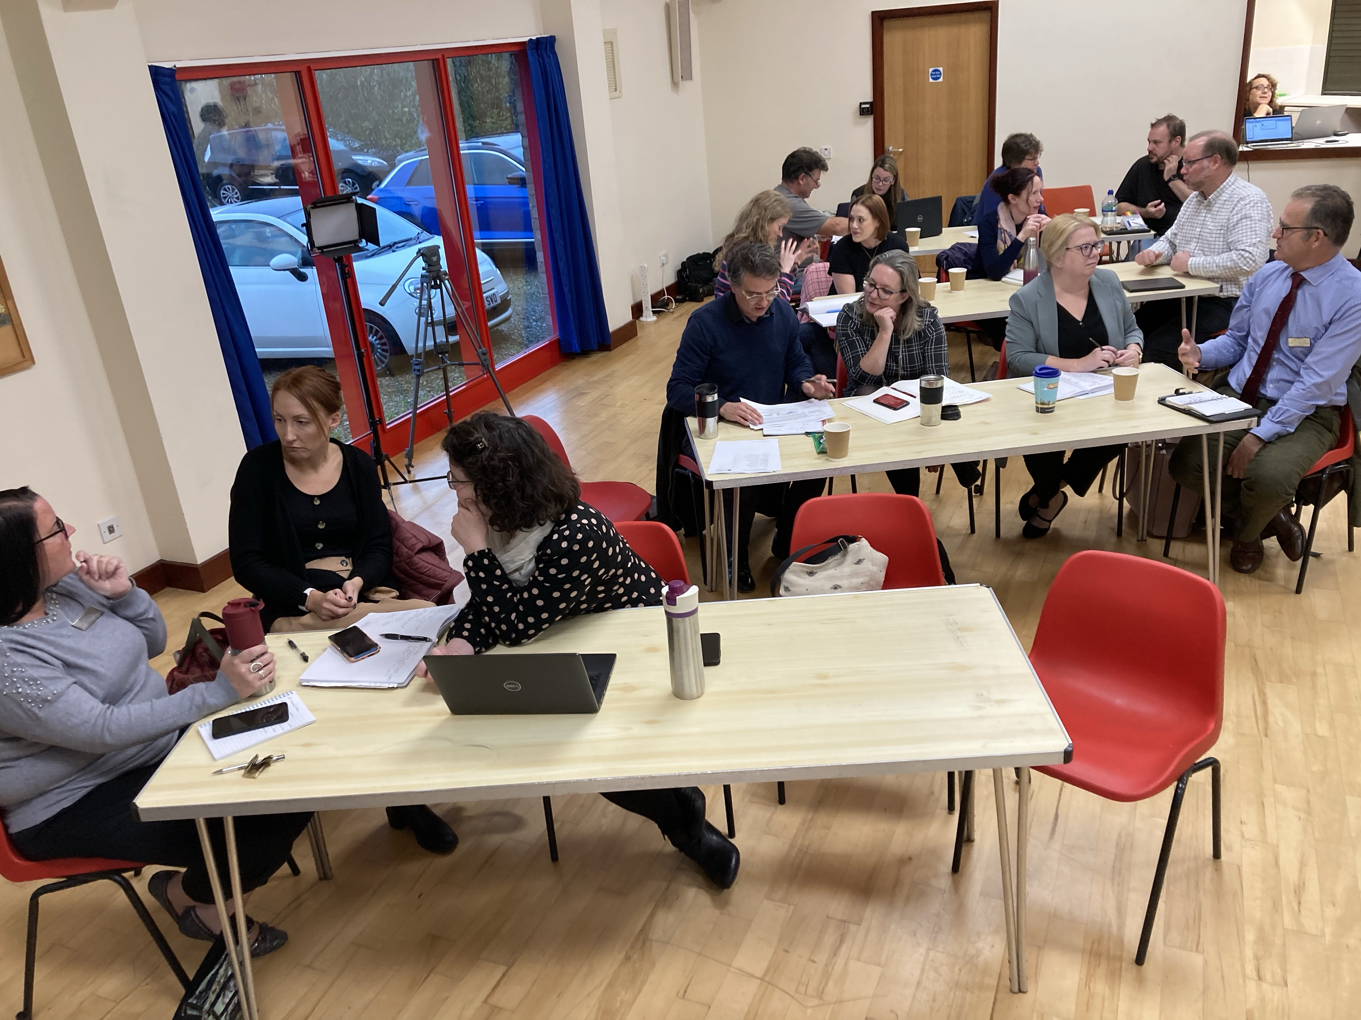
Auto/pedagogy
Authentic learning in the 21st Century seems to have four components:
Learning = N to the power of 4 (all components) hence L=N⁴
Need
kNowledge
Networks
New
Thanks to Emojipedia
Thanks to Open AI
Thanks to staff in Ely Diocese
Thanks to Dad and Resound

Slide 4
Humans learn; machines don’t
When a human Needs to learn…
… they have some kNowledge as a starting point (performative knowledge)
…they look to [their] Networks for support, ideas, wisdom, guidance
… they know they’ve learned when they can apply the learning in a New context

Slide 5
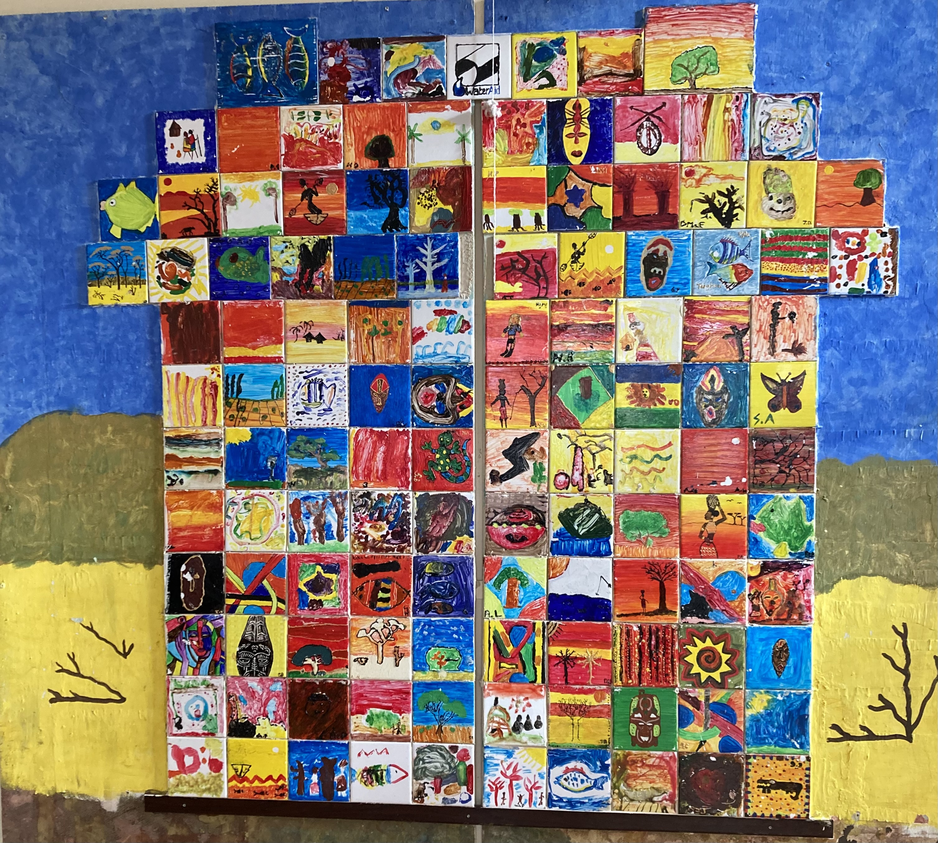
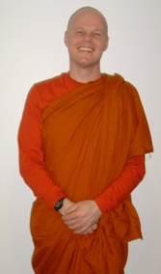
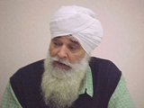
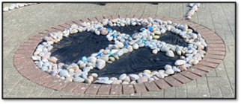
Every primary teacher is a Religion and World Views teacher
Need
Everyone therefore has a professional learning need

Slide 6
Performative kNowledge
What do we kNow already to help our searches?
kNowledge
NNSF
Local Agreed Syllabus

Slide 7
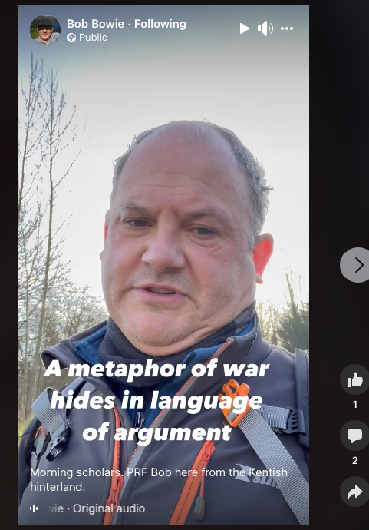
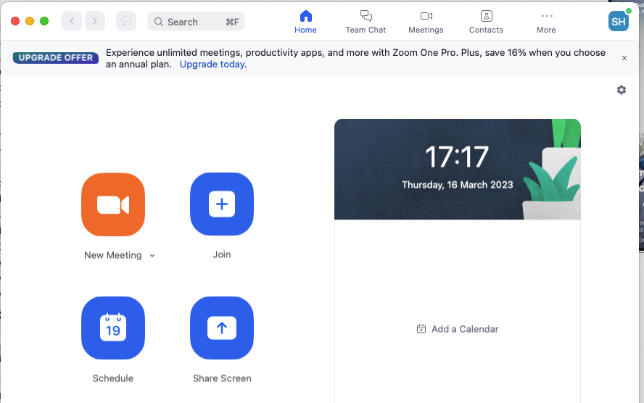
Professional Networks
Collaborative learners co-operate in communities of professionals
(After Wenger E. (2000) Communities of Practice: Learning, Meaning, And Identity)
Networks

Slide 8
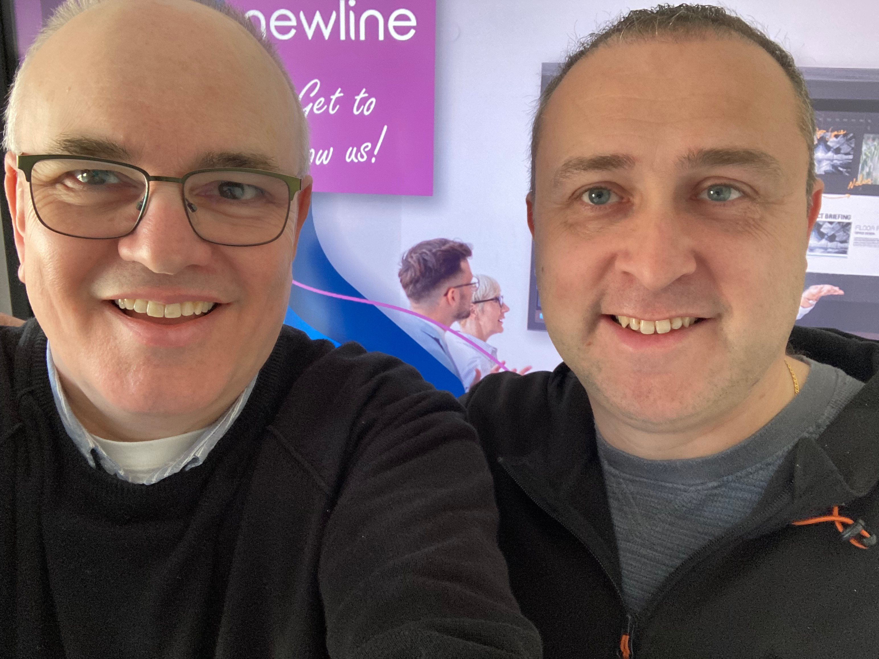
New contexts and apps
“I make no apology for linking my thinking with computer technology” (Maxi Jazz RIP, Reverence, 1996)
Techno-life-changing moments for me:
/sort
<<Edit, Undo>>
<href:> and <mailto:>
Render
New

Slide 9
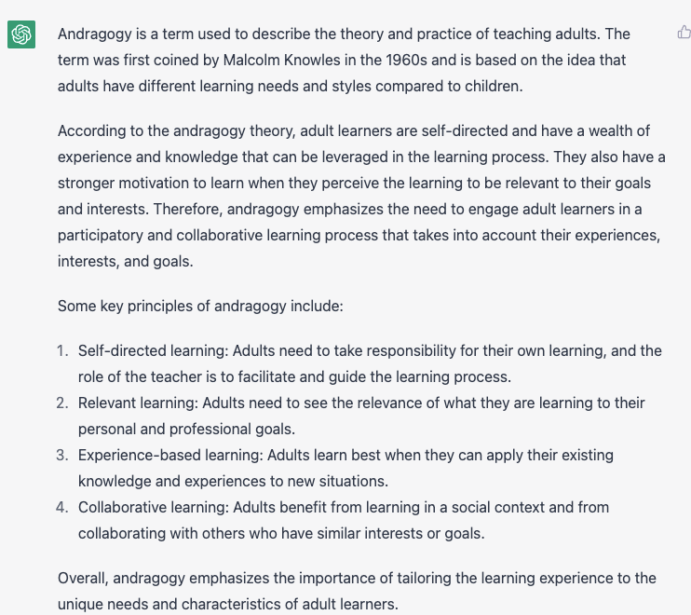
A Relevant ChatGPT response

